Slide 1
Multiple Linear Regression of Student Performance Factors
Chisom Uwakwe, Hangting Lu, and Kevin Coughlin

Slide 2
Our Research
As students, we thought it was important to discover the factors of most importance to getting higher grades.
That’s why we decided to use this simulated dataset from Kaggle (Student Performance (Multiple Linear Regression)) to do some investigation into how to maximize success in classes.

Slide 3
Goals
Though this project, we sought to figure out how the number of hours of sleep, previous scores, number of practice exams used, and hours studied impact the overall performance of a student.
We attempted to create a model that can be used to predict this in order for us and other students to be able to predict the best way to optimize exam performance.

Slide 4
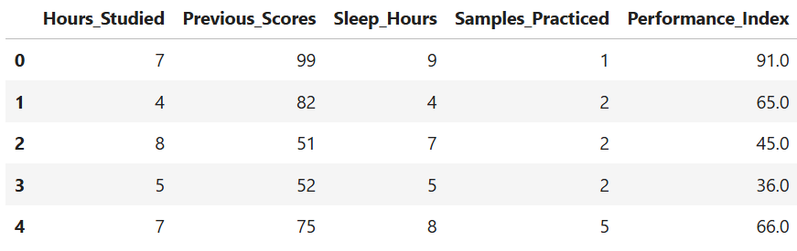
Dataset
As previously stated, the dataset used to create our model came from Kaggle. It includes the following as possible effectors on exam scores:
Hours Studied (1-9)
Previous Scores (40-99)
Sleep Hours (4-9)
Samples Practiced (0-9)
The dependent variable is Performance Index (10-100).

Slide 5
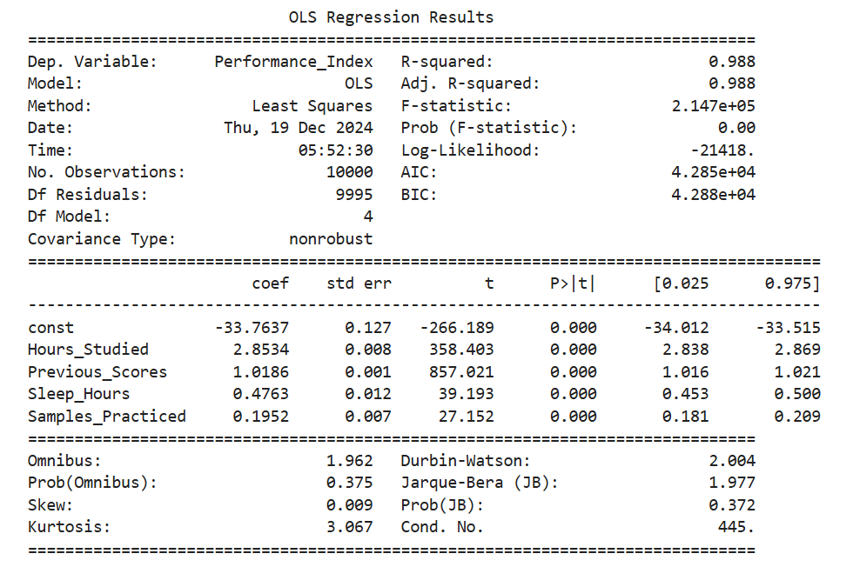
Ordinary Least Squares Regression

Slide 6
OLS Regression (continued)
From the OLS Regression, we found that the model equation is:
Performance Index = -33.76 + 2.85*Hours_Studied + 1.02*Previous_Scores + 0.48*Sleep_Hours + 0.20*Samples_Practiced
This model has an R Squared value of 0.988, indicating a high degree of fit.
The 95% confidence interval for each coefficient is:
Intercept: [-34.012, -33.515]
Hours Studied: [2.838, 2.869]
Previous Scores: [1.016, 1.021]
Sleep Hours: [0.453, 0.500]
Samples Practiced: [0.181, 0.209]
The p-values for all of these values round to 0, indicating that the null hypothesis of the T-test stating that the coefficient is 0 can be rejected. This means that all values are significant in determining the performance index.

Slide 7
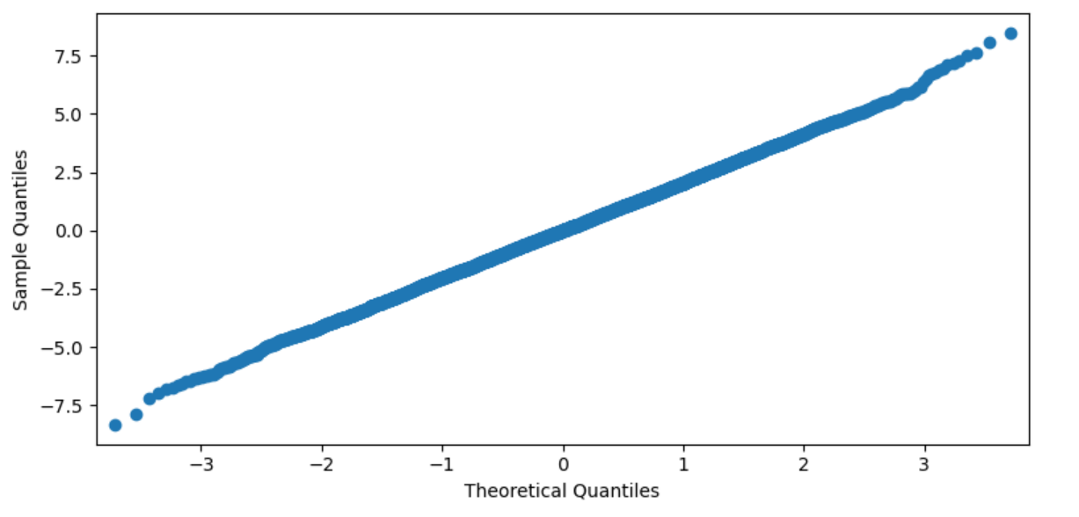
Normally Distributed Residuals
This is a quantile plot created to test whether the residuals of the data was normally distributed. If the residuals were not normally distributed, the model may not be incorrect, but the confidence intervals and P-values would be because they are reliant on the assumption of normal distribution. Because the plot is linear, we can conclude that the residuals are in fact normally distributed.

Slide 8
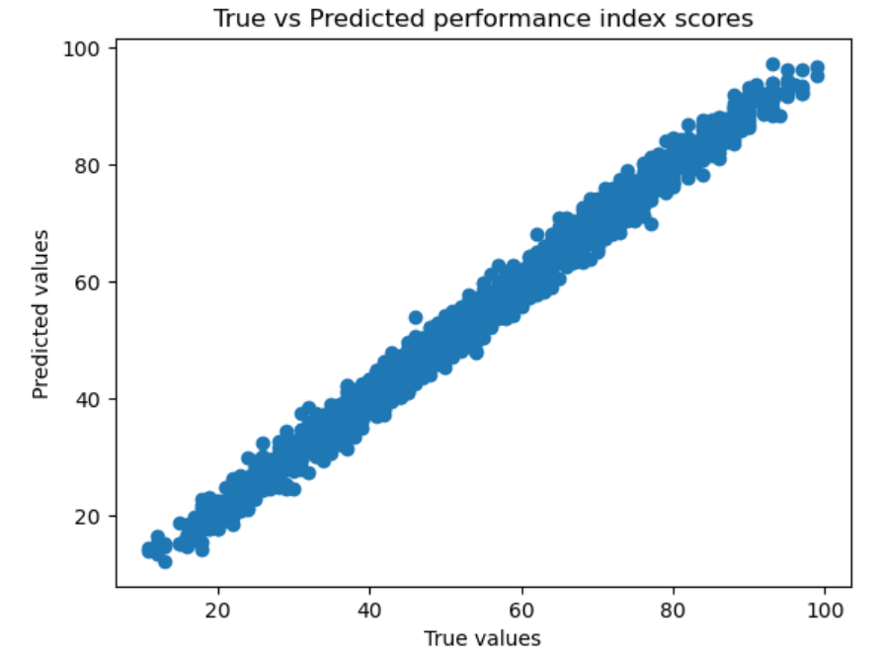
Trained Model
We split our data into a training group and a test group, in order to refine the model and test the modifications. Based on the results, we produced the following figure, which shows a high level of similarity between the predicted performance scores based on the given independent variables and the actual ones.

Slide 9
Trained Model (continued)
Based on our trained model, the coefficients were revised to be the following:
AA
All of these values are within the 95% confidence interval created before, and are very close to the values seen by our original OLS model.

Slide 10
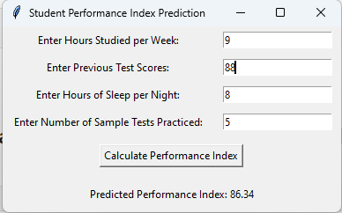
Score Predictor
We expanded the original use of the code to include a score predictor tool. This feature allows for the input of a student’s own variables that could affect performance, and uses our model to predict what their performance score would look like.

Slide 11
Conclusions
Based on the data, it is clear that all of these factors including studying time, prior performance, number of hours of sleep, and number of practice tests taken all have a fairly significant effect on student performance. Within this though, the most significant predictors are time spent studying and, most importantly, prior scores.
An important caveat to this is that this data is all simulated, and did not come from actual student performance. In the future, it would be interesting to see if this could be replicated in a study involving real students. Another interesting aspect that could be investigated is the effects of a healthy breakfast before an exam or whether the results remain consistent on further edges of variables, like less than 4 hours of sleep.

Slide 12
Individual Contributions
Chisom: Draft code, score predictor
Hangting: Code editing and debugging
Kevin: Some code editing, documentation, and slideshow

